Slide 1
Visual Analytics using Tableau
Ram Angadala
Principal Data Scientist
Walmart Global Tech

Slide 2
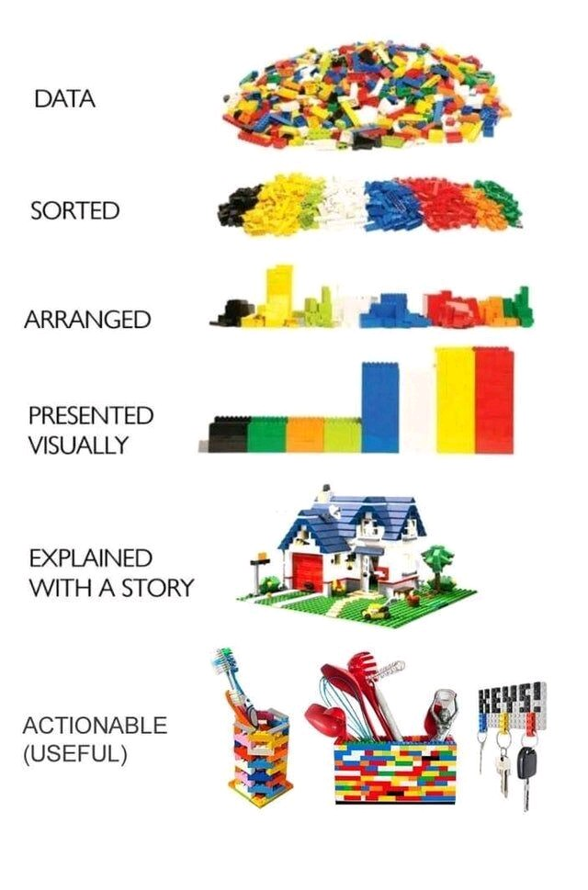
Actionable Insights

Slide 3
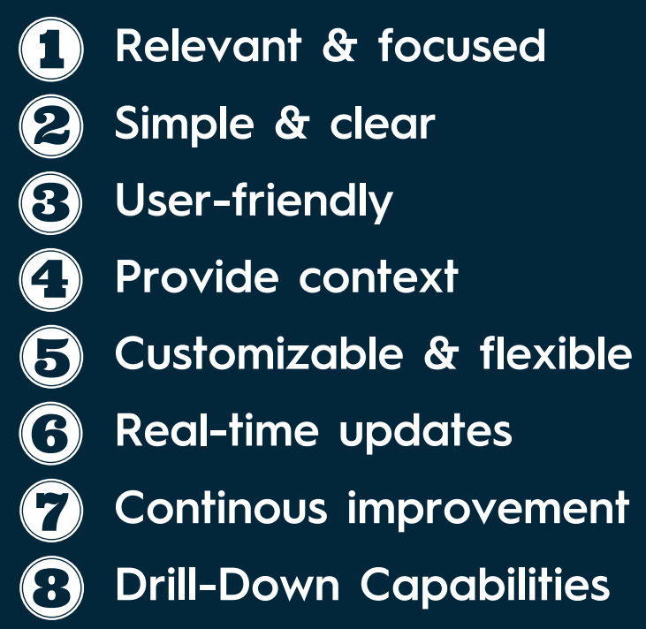
8 TRAITS OF A GREAT DASHBOARD
https://media.licdn.com/dms/document/media/D4E1FAQE-bo6-l1VkuQ/feedshare-document-pdf-analyzed/0/1685795767914?e=1689811200&v=beta&t=ADvZMW7AG5T1XuYADRTlN2RGQ5qZSgjWGJ9gmwm1z9Q
Andy Kriebel

Slide 4
Data Analyst
Data Scientist
Advanced SQL
Advanced Statistics
Advanced Data Manipulations
Advanced Visualization and Story Telling
Value
Data API
Advanced SQL
Advanced Statistics
Advanced Data Manipulations
Advanced Visualization and Story Telling
Value
Data API
Model Development and Deployment
Functional programming Python
https://slidesgo.com/theme/comparison-infographics

Slide 5
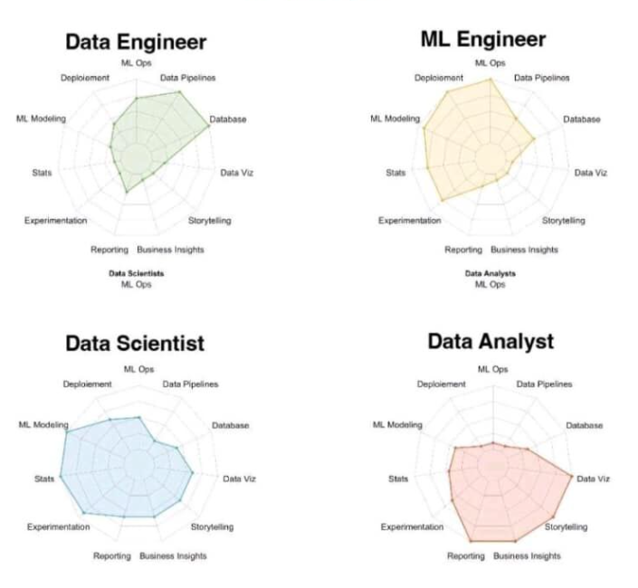
Where you want to be?

Slide 6





Understand Data size
Less than 2GB or 50M rows

Slide 7
Tableau was named after the French word "tableau," which means "a picture" or "a painting."

Slide 8
https://github.com/ramangadala/Tableau-Training

Slide 9
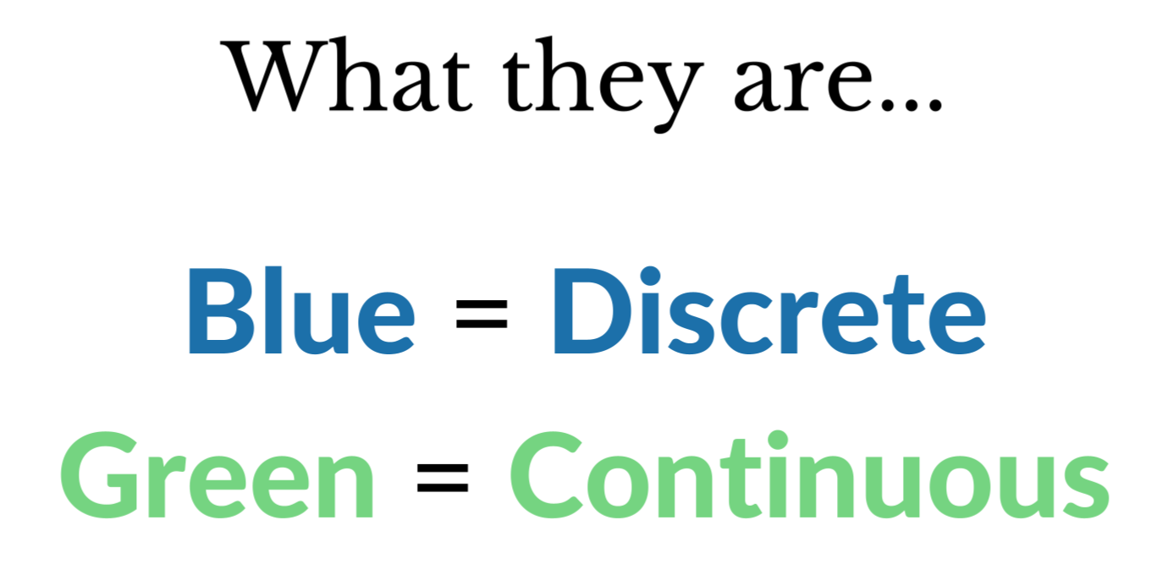

Slide 10
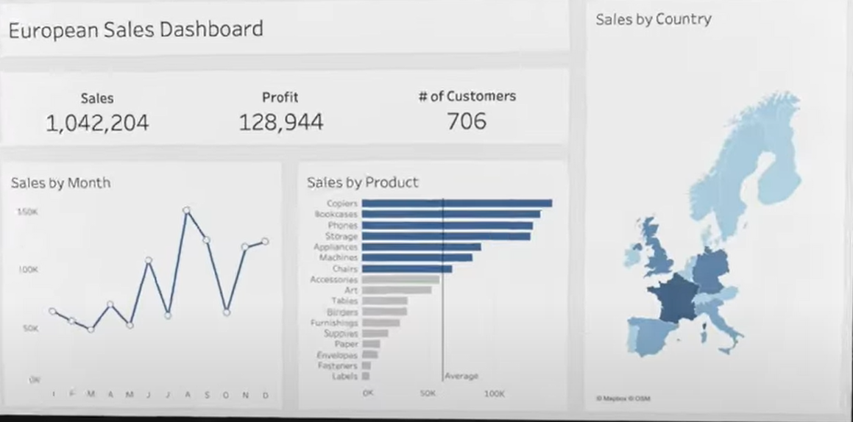
Notes:
Build the charts, customize them, place them in dashboard, add interactivity ….. We are EU company and tasked to create Monthly sales dashboard. Monthly sales, KPIs, Top selling products and Regions

